Slide 1

Fundamentals of Python:
First Programs
Chapter 11: Searching, Sorting,
and Complexity Analysis

Slide 2

Objectives
After completing this chapter, you will be able to:
Measure the performance of an algorithm by obtaining running times and instruction counts with different data sets
Analyze an algorithm’s performance by determining its order of complexity, using big-O notation
Fundamentals of Python: First Programs

Slide 3
Objectives (continued)
Distinguish the common orders of complexity and the algorithmic patterns that exhibit them
Distinguish between the improvements obtained by tweaking an algorithm and reducing its order of complexity
Write a simple linear search algorithm and a simple sort algorithm
Fundamentals of Python: First Programs

Slide 4
Measuring the Efficiency of Algorithms
When choosing algorithms, we often have to settle for a space/time tradeoff
  An algorithm can be designed to gain faster run times at the cost of using extra space (memory), or the other way around
Memory is now quite inexpensive for desktop and laptop computers, but not yet for miniature devices
Fundamentals of Python: First Programs

Slide 5
Measuring the Run Time of an Algorithm
One way to measure the time cost of an algorithm is to use computer’s clock to obtain actual run time
  Benchmarking or profiling
Can use time() in time module
  Returns number of seconds that have elapsed between current time on the computer’s clock and January 1, 1970
Fundamentals of Python: First Programs

Slide 6
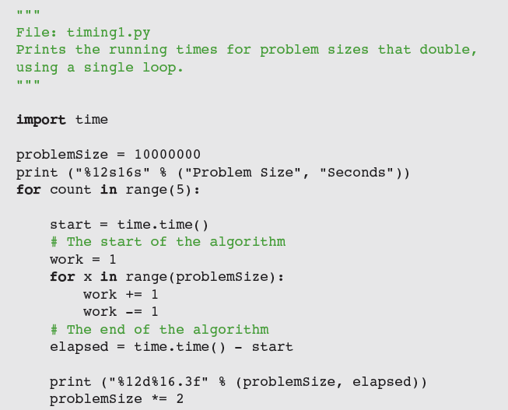
Measuring the Run Time of an Algorithm (continued)
Fundamentals of Python: First Programs

Slide 7
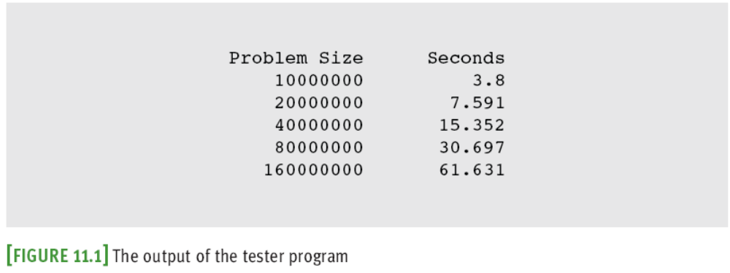
Measuring the Run Time of an Algorithm (continued)
Fundamentals of Python: First Programs

Slide 8
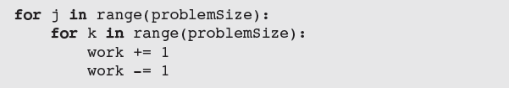
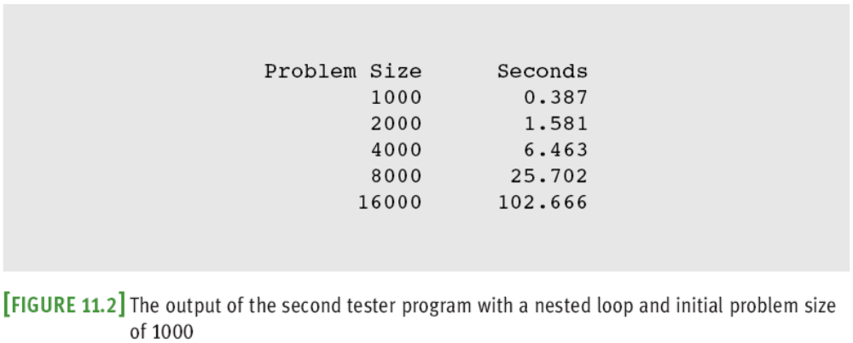
Measuring the Run Time of an Algorithm (continued)
Fundamentals of Python: First Programs

Slide 9
Measuring the Run Time of an Algorithm (continued)
This method permits accurate predictions of the running times of many algorithms
Problems:
  Different hardware platforms have different processing speeds, so the running times of an algorithm differ from machine to machine
    Running time varies with OS and programming language too
  It is impractical to determine the running time for some algorithms with very large data sets
Fundamentals of Python: First Programs

Slide 10
Counting Instructions
Another technique is to count the instructions executed with different problem sizes
  We count the instructions in the high-level code in which the algorithm is written, not instructions in the executable machine language program
Distinguish between:
  Instructions that execute the same number of times regardless of problem size
    For now, we ignore instructions in this class
  Instructions whose execution count varies with problem size
Fundamentals of Python: First Programs

Slide 11
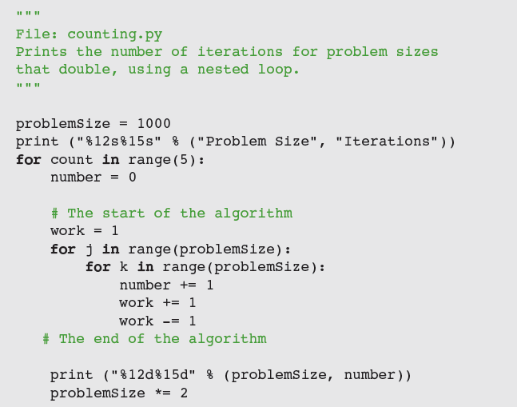
Counting Instructions (continued)
Fundamentals of Python: First Programs

Slide 12
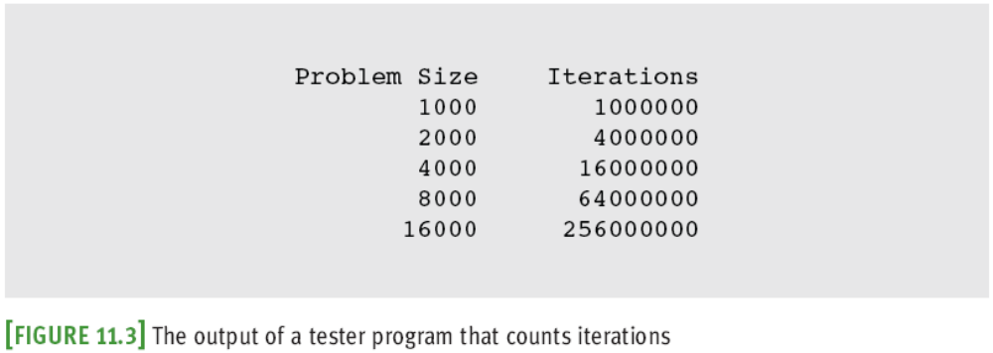
Counting Instructions (continued)
Fundamentals of Python: First Programs

Slide 13
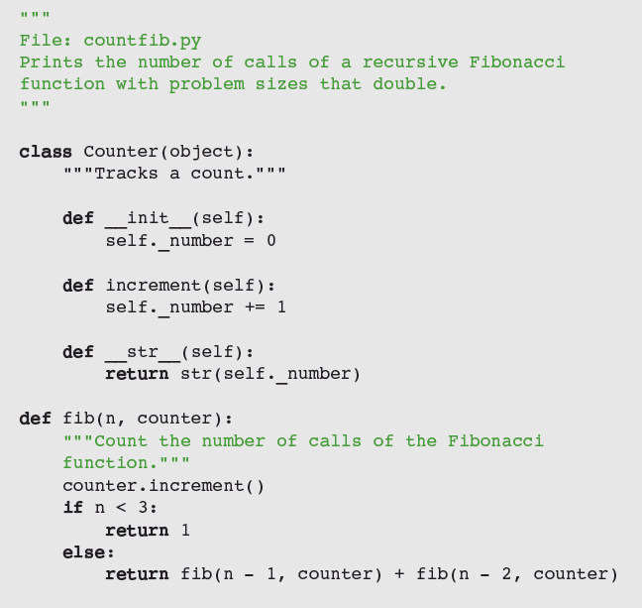
Counting Instructions (continued)
Fundamentals of Python: First Programs

Slide 14
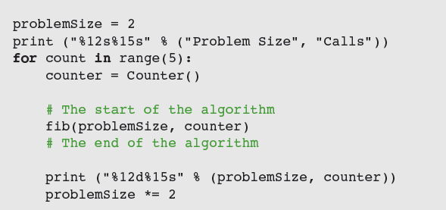
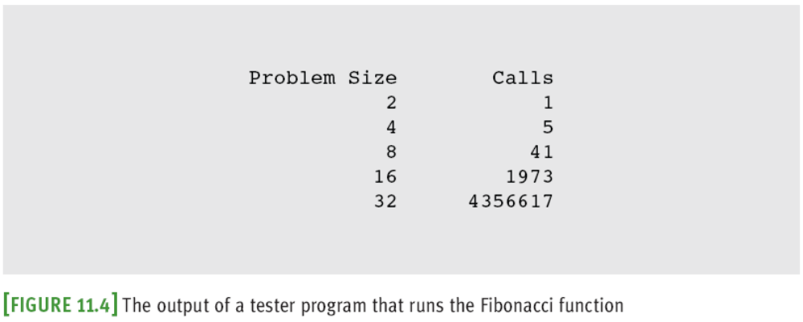
Counting Instructions (continued)
Fundamentals of Python: First Programs

Slide 15
Measuring the Memory Used by an Algorithm
A complete analysis of the resources used by an algorithm includes the amount of memory required
We focus on rates of potential growth
Some algorithms require the same amount of memory to solve any problem
Other algorithms require more memory as the problem size gets larger
Fundamentals of Python: First Programs

Slide 16
Complexity Analysis
Complexity analysis entails reading the algorithm and using pencil and paper to work out some simple algebra
  Used to determine efficiency of algorithms
  Allows us to rate them independently of platform-dependent timings or impractical instruction counts
Fundamentals of Python: First Programs

Slide 17
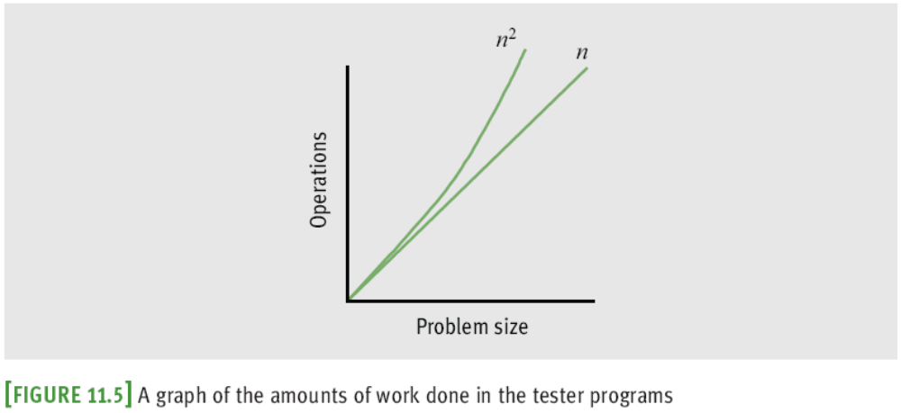
Orders of Complexity
Consider the two counting loops discussed earlier:
When we say “work,” we usually mean the number of iterations of the most deeply nested loop
Fundamentals of Python: First Programs

Slide 18
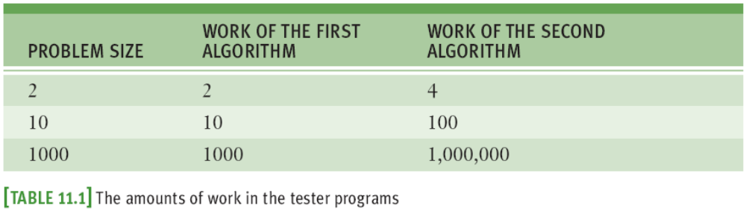
Orders of Complexity (continued)
The performances of these algorithms differ by what we call an order of complexity
  The first algorithm is linear
  The second algorithm is quadratic
Fundamentals of Python: First Programs

Slide 19
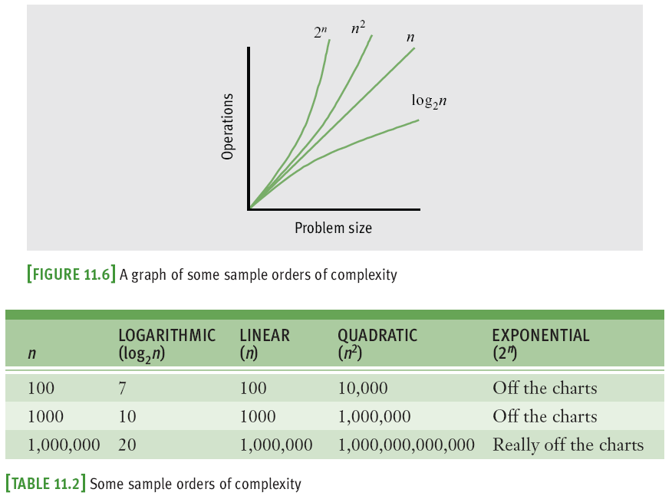
Orders of Complexity (continued)
Fundamentals of Python: First Programs

Slide 20
Big-O Notation
The amount of work in an algorithm typically is the sum of several terms in a polynomial
  We focus on one term as dominant
As n becomes large, the dominant term becomes so large that the amount of work represented by the other terms can be ignored
  Asymptotic analysis
Big-O notation: used to express the efficiency or computational complexity of an algorithm
Fundamentals of Python: First Programs

Slide 21
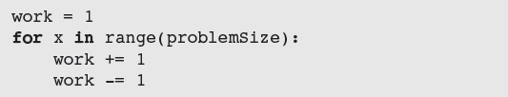
The Role of the Constant of Proportionality
The constant of proportionality involves the terms and coefficients that are usually ignored during big-O analysis
  However, when these items are large, they may have an impact on the algorithm, particularly for small and medium-sized data sets
The amount of abstract work performed by the following algorithm is 3n + 1
Fundamentals of Python: First Programs

Slide 22
Search Algorithms
We now present several algorithms that can be used for searching and sorting lists
  We first discuss the design of an algorithm,
  We then show its implementation as a Python function, and,
  Finally, we provide an analysis of the algorithm’s computational complexity
To keep things simple, each function processes a list of integers
Fundamentals of Python: First Programs

Slide 23
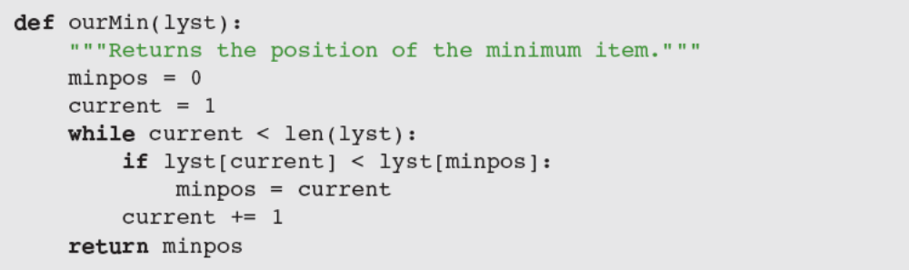
Search for a Minimum
Python’s min function returns the minimum or smallest item in a list
Alternative version:
  n – 1 comparisons for a list of size n
    O(n)
Fundamentals of Python: First Programs

Slide 24
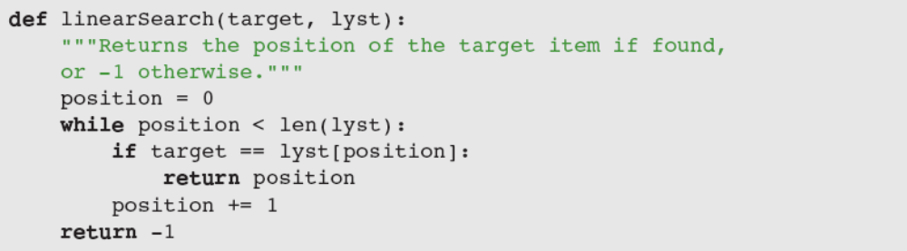
Linear Search of a List
Python’s in operator is implemented as a method named __contains__ in the list class
  Uses a sequential search or a linear search
Python code for a linear search function:
  Analysis is different from previous one
Fundamentals of Python: First Programs

Slide 25
Best-Case, Worst-Case, and Average-Case Performance
Analysis of a linear search considers three cases:
  In the worst case, the target item is at the end of the list or not in the list at all
    O(n)
  In the best case, the algorithm finds the target at the first position, after making one iteration
    O(1)
  Average case: add number of iterations required to find target at each possible position; divide sum by n
    O(n)
Fundamentals of Python: First Programs

Slide 26
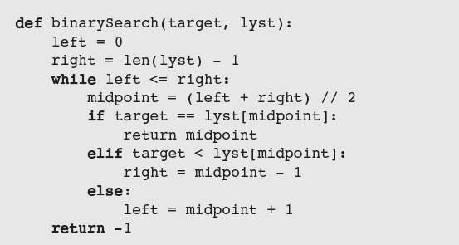
Binary Search of a List
A linear search is necessary for data that are not arranged in any particular order
When searching sorted data, use a binary search
Fundamentals of Python: First Programs

Slide 27
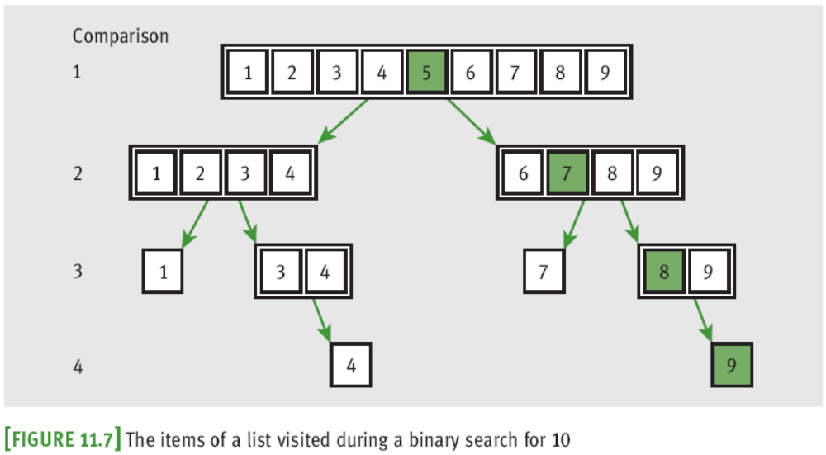
Binary Search of a List (continued)
  More efficient than linear search
    Additional cost has to do with keeping list in order
Fundamentals of Python: First Programs

Slide 28
Comparing Data Items
To allow algorithms to use comparison operators with a new class of objects, define the __eq__, __lt__, and __gt__ methods in that class
  Header: def __it__(self, other):
  Should return:
    0 when the two objects are equal
    A number less than 0 if self < other
    A number greater than 0 if self > other
Fundamentals of Python: First Programs

Slide 29
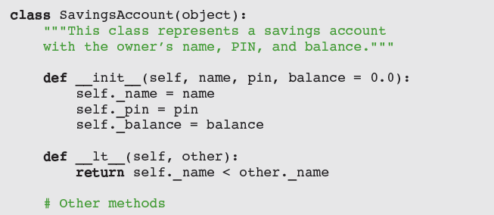
Comparing Data Items
Fundamentals of Python: First Programs

Slide 30
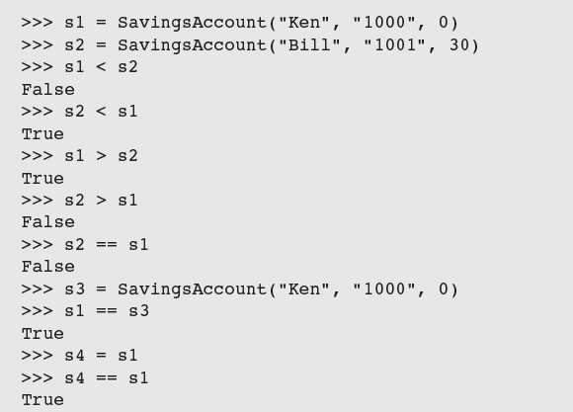
Comparing Data Items (continued)
Fundamentals of Python: First Programs

Slide 31
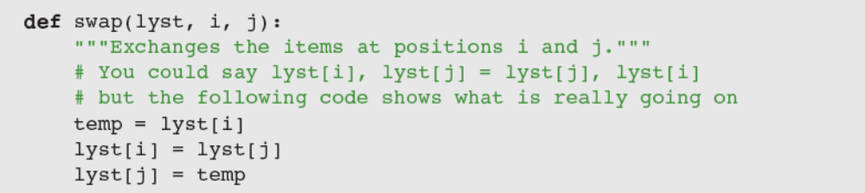
Sort Algorithms
The sort functions that we develop here operate on a list of integers and uses a swap function to exchange the positions of two items in the list
Fundamentals of Python: First Programs

Slide 32
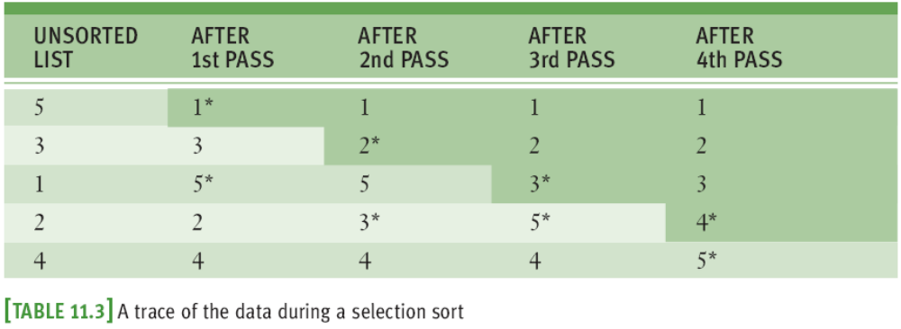
Selection Sort
Perhaps the simplest strategy is to search the entire list for the position of the smallest item
  If that position does not equal the first position, the algorithm swaps the items at those positions
Fundamentals of Python: First Programs

Slide 33
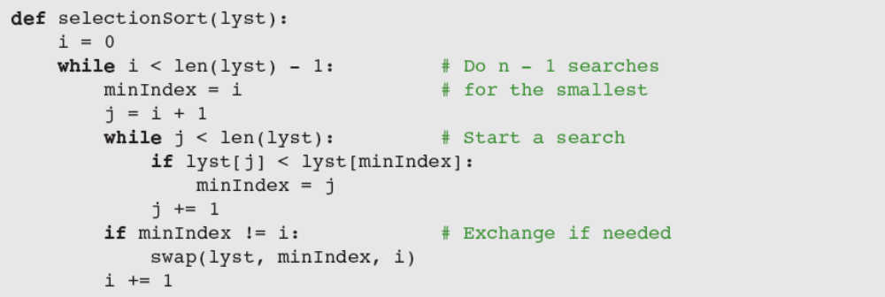
Selection Sort (continued)
Selection sort is O(n²) in all cases
For large data sets, the cost of swapping items might also be significant
  This additional cost is linear in worst/average cases
Fundamentals of Python: First Programs

Slide 34
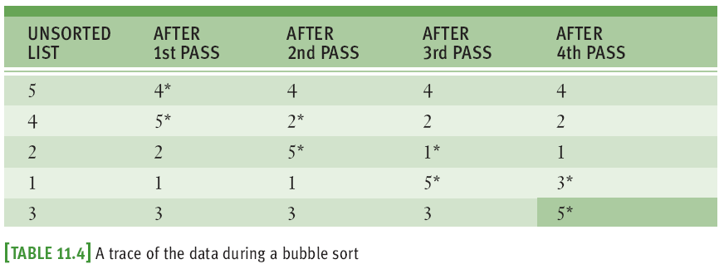
Bubble Sort
Starts at beginning of list and compares pairs of data items as it moves down to the end
  When items in pair are out of order, swap them
Fundamentals of Python: First Programs

Slide 35
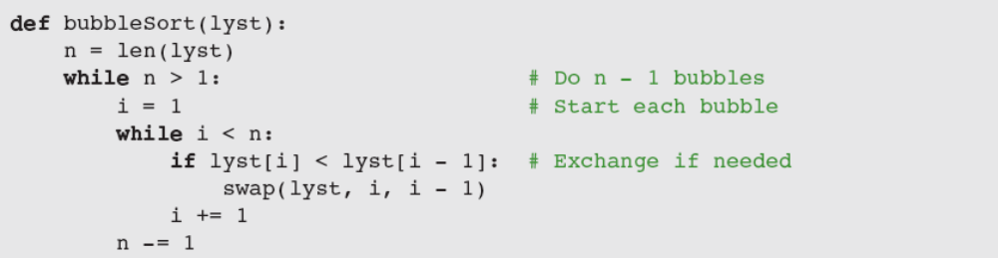
Bubble Sort (continued)
Bubble sort is O(n²)
Will not perform any swaps if list is already sorted
Worst-case behavior for exchanges is greater than linear
Can be improved, but average case is still O(n²)
Fundamentals of Python: First Programs

Slide 36
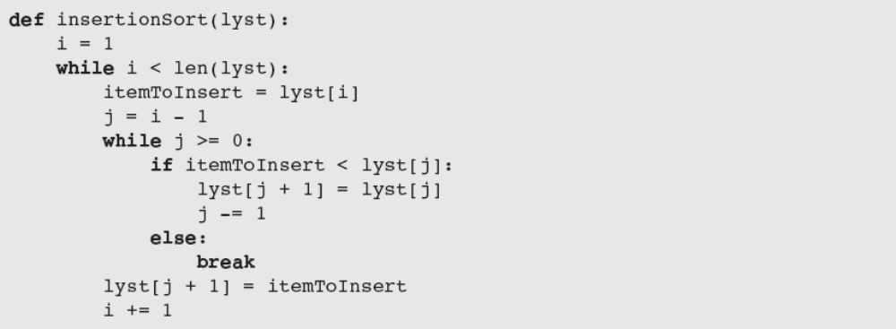
Insertion Sort
Worst-case behavior of insertion sort is O(n²)
Fundamentals of Python: First Programs

Slide 37
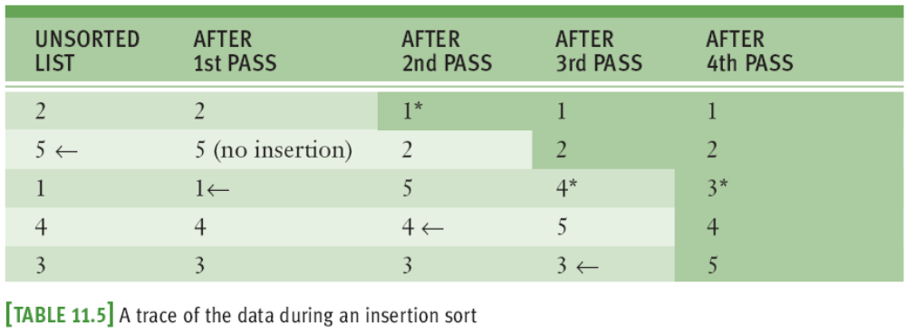
Insertion Sort (continued)
The more items in the list that are in order, the better insertion sort gets until, in the best case of a sorted list, the sort’s behavior is linear
In the average case, insertion sort is still quadratic
Fundamentals of Python: First Programs

Slide 38
Best-Case, Worst-Case, and Average-Case Performance Revisited
Thorough analysis of an algorithm’s complexity divides its behavior into three types of cases:
  Best case
  Worst case
  Average case
There are algorithms whose best-case and average-case performances are similar, but whose performance can degrade to a worst case
When choosing/developing an algorithm, it is important to be aware of these distinctions
Fundamentals of Python: First Programs

Slide 39
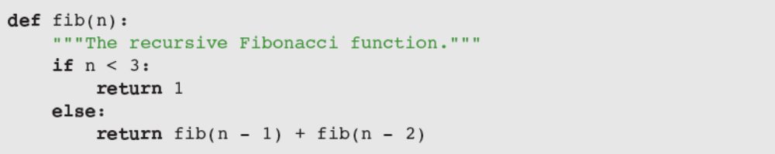
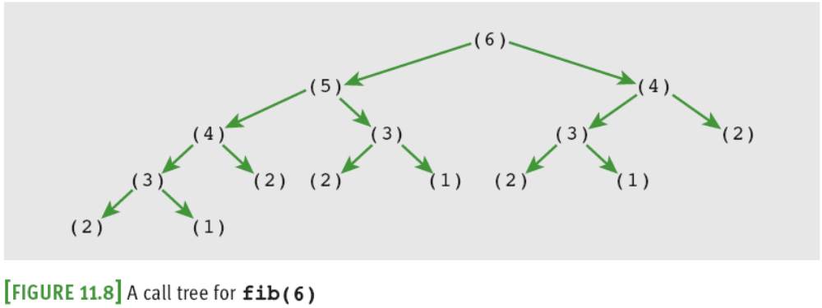
An Exponential Algorithm: Recursive Fibonacci
Fundamentals of Python: First Programs

Slide 40
An Exponential Algorithm: Recursive Fibonacci (continued)
Exponential algorithms are generally impractical to run with any but very small problem sizes
Recursive functions that are called repeatedly with same arguments can be made more efficient by technique called memoization
  Program maintains a table of the values for each argument used with the function
  Before the function recursively computes a value for a given argument, it checks the table to see if that argument already has a value
Fundamentals of Python: First Programs

Slide 41
Converting Fibonacci to a Linear Algorithm
Pseudocode:
  Set sum to 1
  Set first to 1
  Set second to 1
  Set count to 3
  While count <= N
  Set sum to first + second
  Set first to second
  Set second to sum
  Increment count
Fundamentals of Python: First Programs

Slide 42
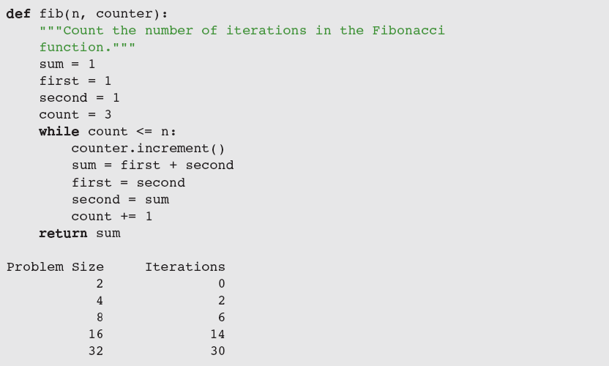
Converting Fibonacci to a Linear Algorithm (continued)
Fundamentals of Python: First Programs

Slide 43
Case Study: An Algorithm Profiler
Profiling: measuring an algorithm’s performance, by counting instructions and/or timing execution
Request:
  Write a program to allow profiling of sort algorithms
Analysis:
  Configure a sort algorithm to be profiled as follows:
    Define sort function to receive a Profiler as a 2nd parameter
    In algorithm’s code, run comparison() and exchange() with the Profiler object where relevant, to count comparisons and exchanges
Fundamentals of Python: First Programs

Slide 44
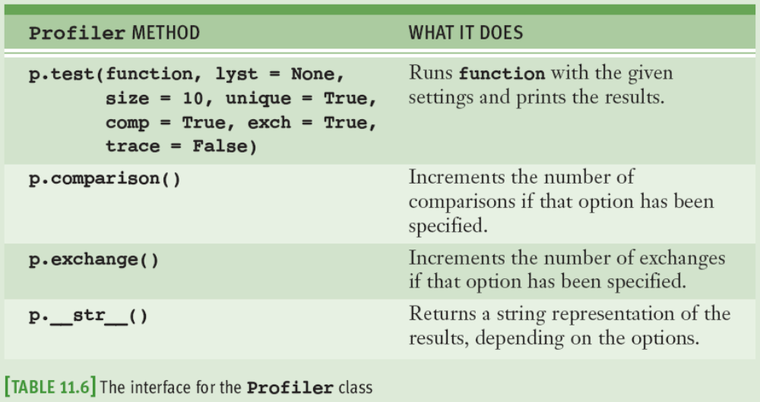
Case Study: An Algorithm Profiler (continued)
Fundamentals of Python: First Programs

Slide 45
Case Study: An Algorithm Profiler (continued)
Design:
  Two modules:
    profiler—defines the Profiler class
    algorithms—defines the sort functions, as configured for profiling
Implementation (Coding):
  Next slide shows a partial implementation of the algorithms module
Fundamentals of Python: First Programs

Slide 46
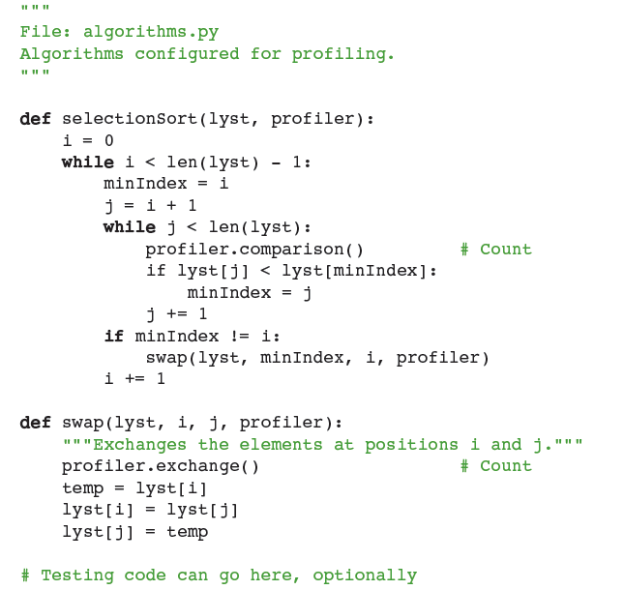
Case Study: Algorithm Profiler (cont’d)
Fundamentals of Python: First Programs

Slide 47
Summary
Different algorithms can be ranked according to time and memory resources that they require
Running time of an algorithm can be measured empirically using computer’s clock
Counting instructions provides measurement of amount of work that algorithm does
Rate of growth of algorithm’s work can be expressed as a function of the size of its problem instances
Big-O notation is a common way of expressing an algorithm’s runtime behavior
Fundamentals of Python: First Programs

Slide 48
Summary (continued)
Common expressions of run-time behavior are O(log₂n), O(n), O(n²), and O(k^{n})
An algorithm can have different best-case, worst-case, and average-case behaviors
In general, it is better to try to reduce the order of an algorithm’s complexity than it is to try to enhance performance by tweaking the code
Binary search is faster than linear search (but data must be ordered)
Exponential algorithms are impractical to run with large problem sizes
Fundamentals of Python: First Programs

